Slide 1
Data Management and Analysis
Sentiment Analysis
Walter Quattrociocchi
walter.quattrociocchi@uniroma1.it

Slide 2
Subjectivity / sentiment / opinion
Sentiment analysis and Opinion mining are to a large extent synonyms
They both refer to the idea of subjectivity and specifically private states, which are not subject to objective verification
Tastes, feelings, beliefs, desires, …
Do humans agree on sentiment? Not always ...
Pang, Bo, and Lillian Lee. "Opinion mining and sentiment analysis." Foundations and Trends in Information Retrieval 2, no. 1–2 (2008): 1-135.

Slide 3
Basic task: polarity
Is the attitude of the holder towards the target in a text positive or negative?
Attitude = disposition (not merely the mood)
Holder = often the author of the text
Target = entity the text refers to
Typical approach
Supervised classification with two classes

Slide 4
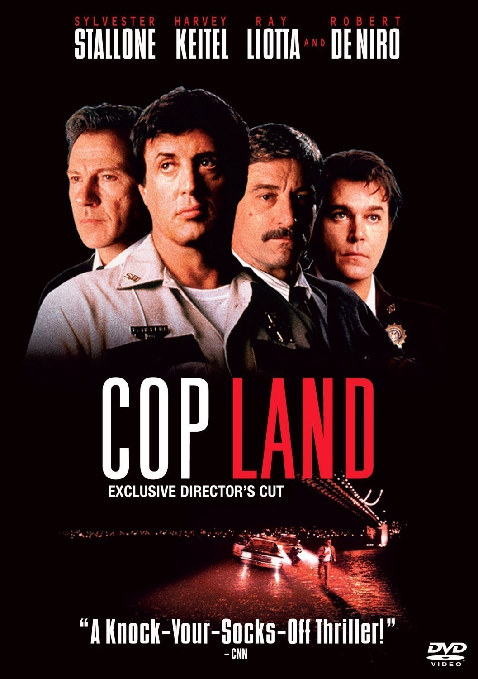
The devil is in the details
This film should be brilliant. It sounds like a great plot, the actors are first grade, and the supporting cast is good as well, and Stallone is attempting to deliver a good performance. However, it can't hold up. Although the acting is fantastic (even Stallone isn't bad) the directing and story is dull and long winded.
http://www.imdb.com/reviews/101/10185.html

Slide 5
Many problems in practice
Polarity flippers
Negation: “not great”
Contrastive discourse connectives: “I used to hate it, but it tastes good”
Multiword expressions
“shit” vs “the shit” (positive slang in US ca. 1990s)
Thwarted expectations
“It could have been a brilliant masterpiece. It wasn’t”
No loaded words (e.g. polite or sarcastic expressions)
“If you are reading this because it is your darling fragrance, please wear it at home exclusively, and tape the windows shut.” (review by Luca Turin and Tania Sanchez of the Givenchy perfume Amarige, in Perfumes: The Guide, Viking 2008.)
http://u.cs.biu.ac.il/~89-680/sentiment.pdf

Slide 6
“isn't bad”
“It is not a bullish market” is tokenized into:
it
is
not
a_n
bullish_n
market_n
Das, Sanjiv, and Mike Chen. "Yahoo! for Amazon: Extracting market sentiment from stock message boards." In Proceedings of the Asia Pacific finance association annual conference (APFA), vol. 35, p. 43. 2001.

Slide 7
Some lexical resources
SentiWordNet http://sentiwordnet.isti.cnr.it/
ANEW http://csea.phhp.ufl.edu/media.html#bottommedia
LIWC https://liwc.wpengine.com/

Slide 8
Building a lexical resource
Find some ground truth (e.g., text and polarity)
Automatically derive…
Rules
Significant features
Other
Manually clean results
Profit!

Slide 9
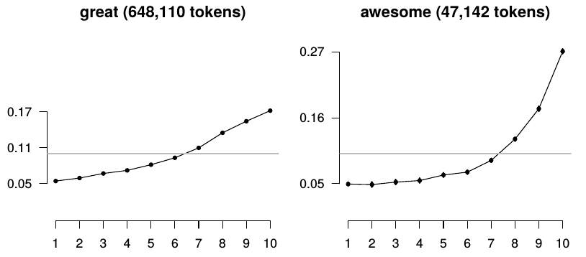
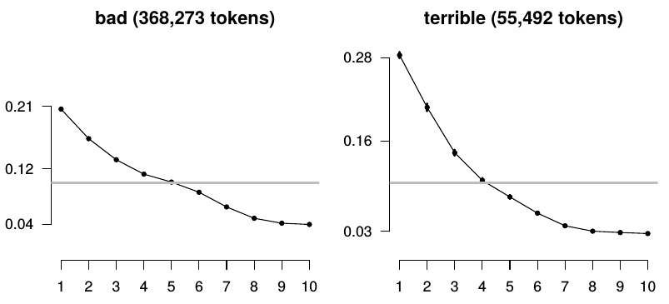
IMDB: words and score (1-10)
Potts, Christopher. "On the negativity of negation." In Semantics and Linguistic Theory, vol. 20, pp. 636-659. 2010.

Slide 10
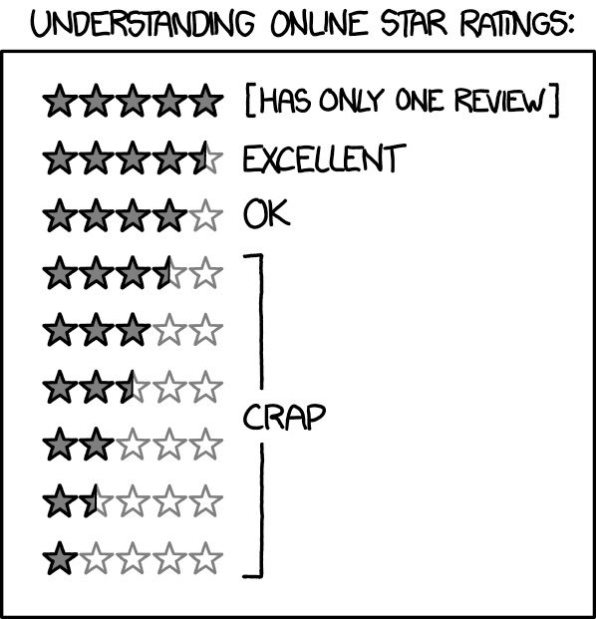
https://xkcd.com/1098/

Slide 11
Emoticons and emojis can be used
Message contains :-) or variant or good emoji
→ positive message
Message contains :-( or variant or bad emoji
→ negative message

Slide 12
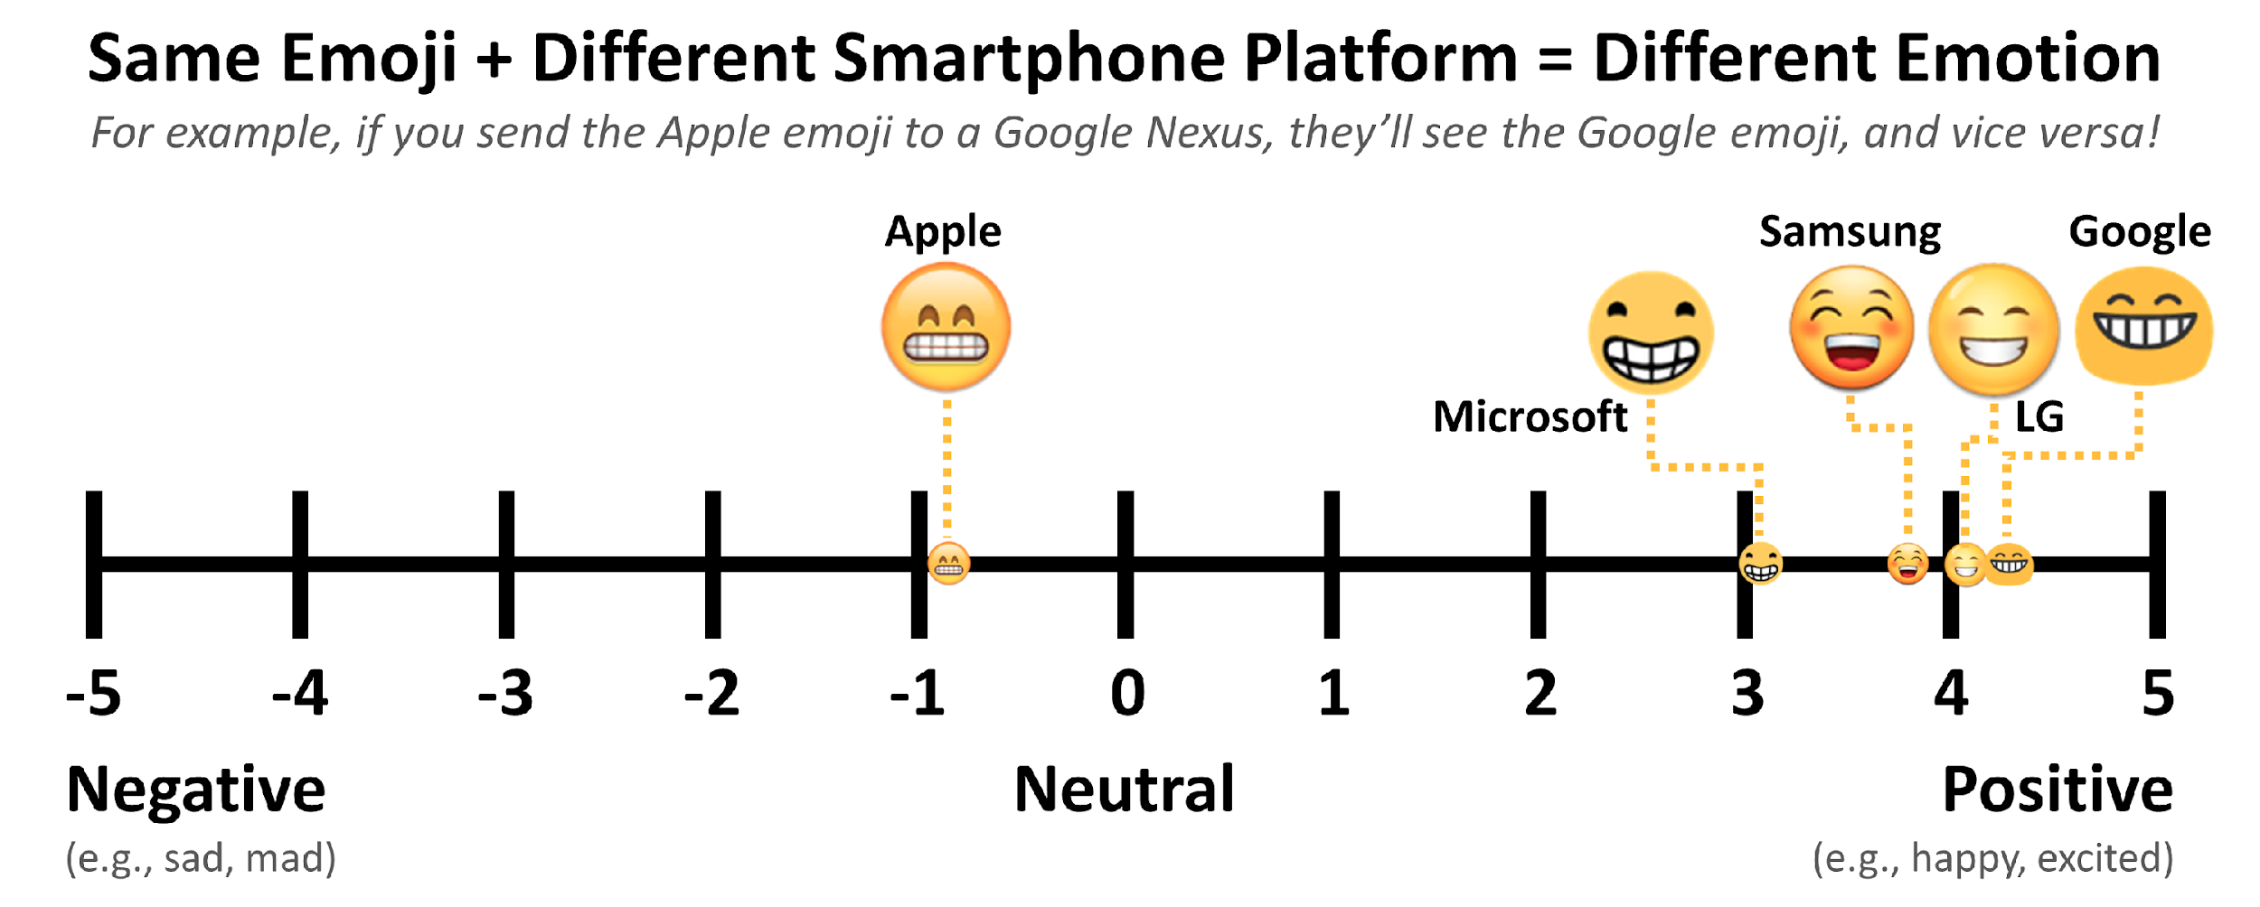
Emojis can be inconsistent

Slide 13
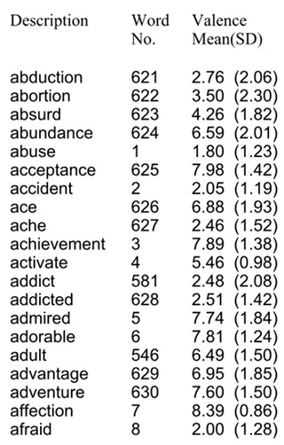
Example: ANEW
1 is most negative
…
9 is most positive
http://csea.phhp.ufl.edu/media.html#bottommedia

Slide 14
Building a lexical resource
Find some ground truth with polarity and text
E.g., reviews online with stars or scores
Propagate using rules
“and” indicates same polarity (“good and classy”)
“but” indicates changed polarity
Other forms of propagation … might be probabilistic

Slide 15
More problems: context
Perspective
Is “entry-level” or “great value” good or bad?
Authority
Well-informed opinions should matter more
Spam
There are tons of fake reviews, both positive and negative

Slide 16
Beyond polarity
Polarity is positive or negative
But how strong is the opinion?
That’s called “arousal” which is the intensity of the sentiment
Attributes might be important even if they don’t imply a polarity
E.g., restaurant is good for families with children
Multi-dimensional emotions

Slide 17
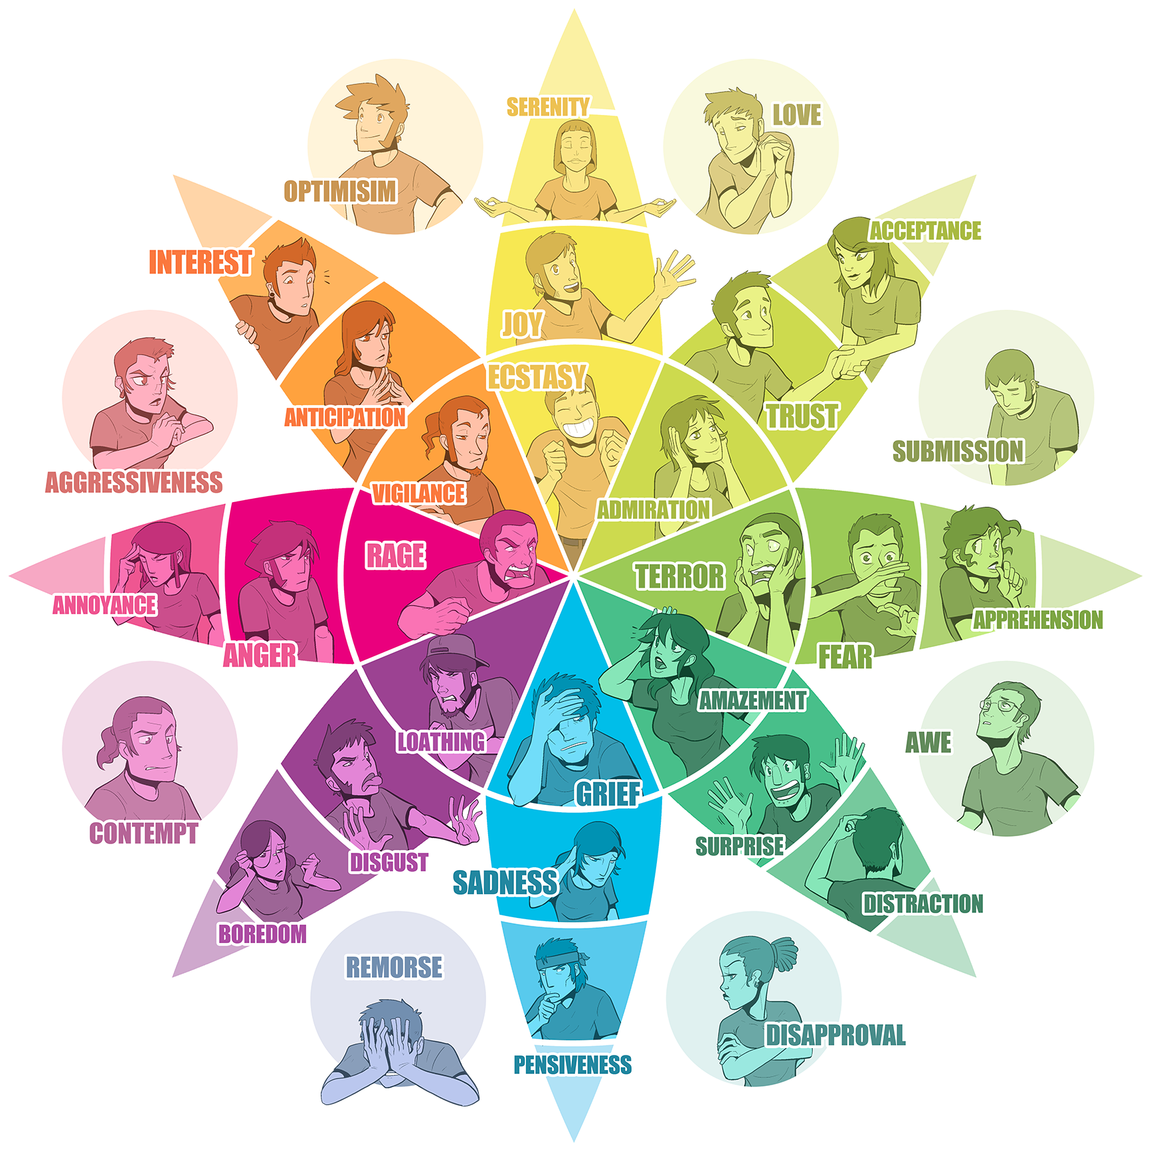
Robert Plutchik’s Wheel

